Slide 1
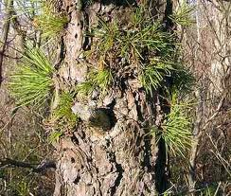
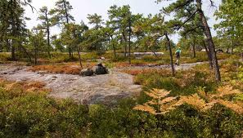
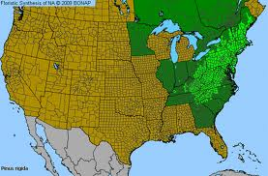
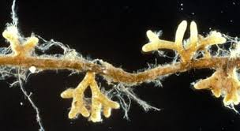
Mycorrhizae of Pitch Pine (Pinus rigida)
- Collaboration with Mary Ann Bruns

Slide 2
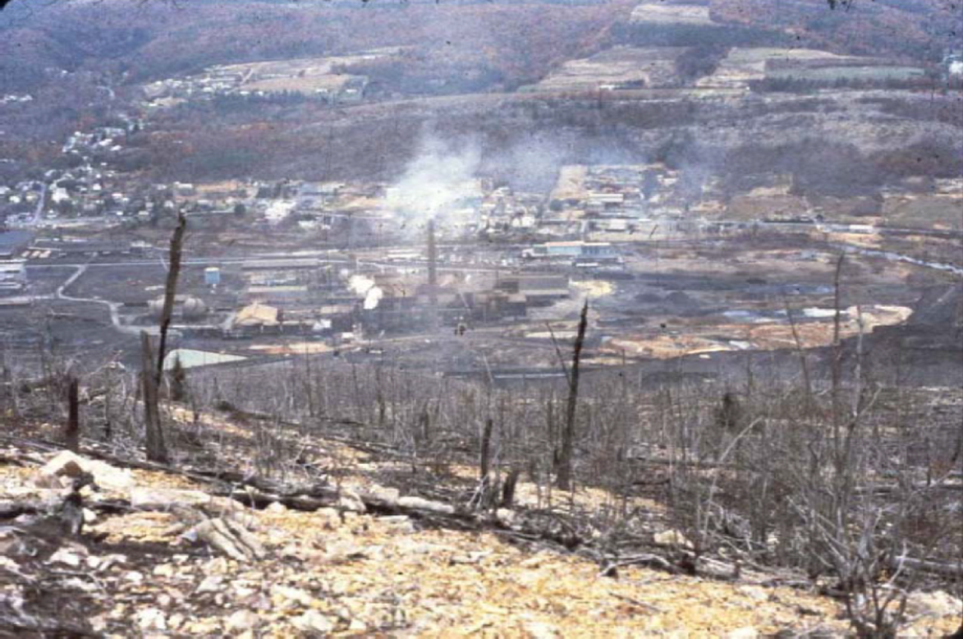
1980
http://www.epa.gov/aml/tech/palmerton.pdf
From the 1880’s through 1987, atmospheric pollution from zinc
smelting in Palmerton, PA decimated thousands of acres of forests
on the Blue Mountain Ridge - downwind of the town

Slide 3
EPA photo
Because of the high concentrations of heavy metals in the soils, in 1987 the ridge was designated an EPA Superfund site

Slide 4
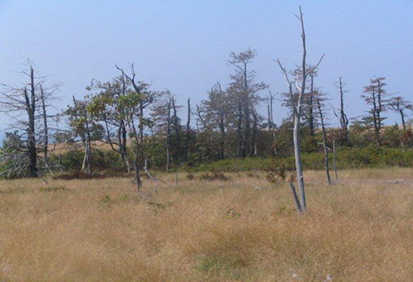
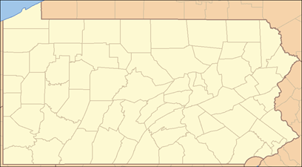
Federal remediation efforts have since met with only limited success
EPA
photos
2012

Slide 5
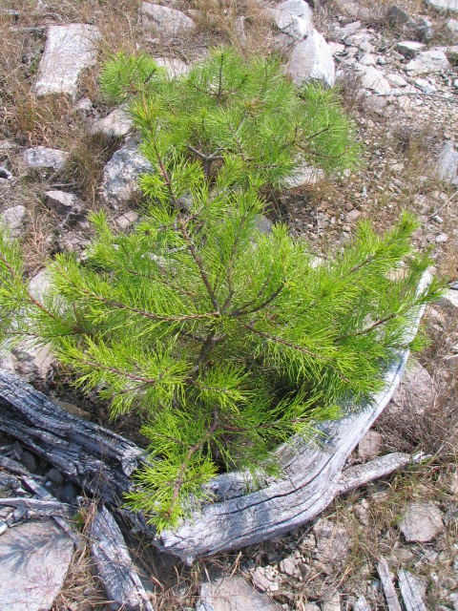
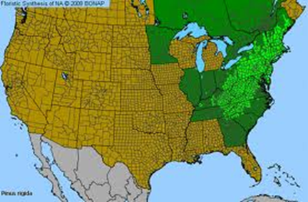
One of the few tree species able to re-establish is the Pitch Pine
(Pinus rigida)

Slide 6
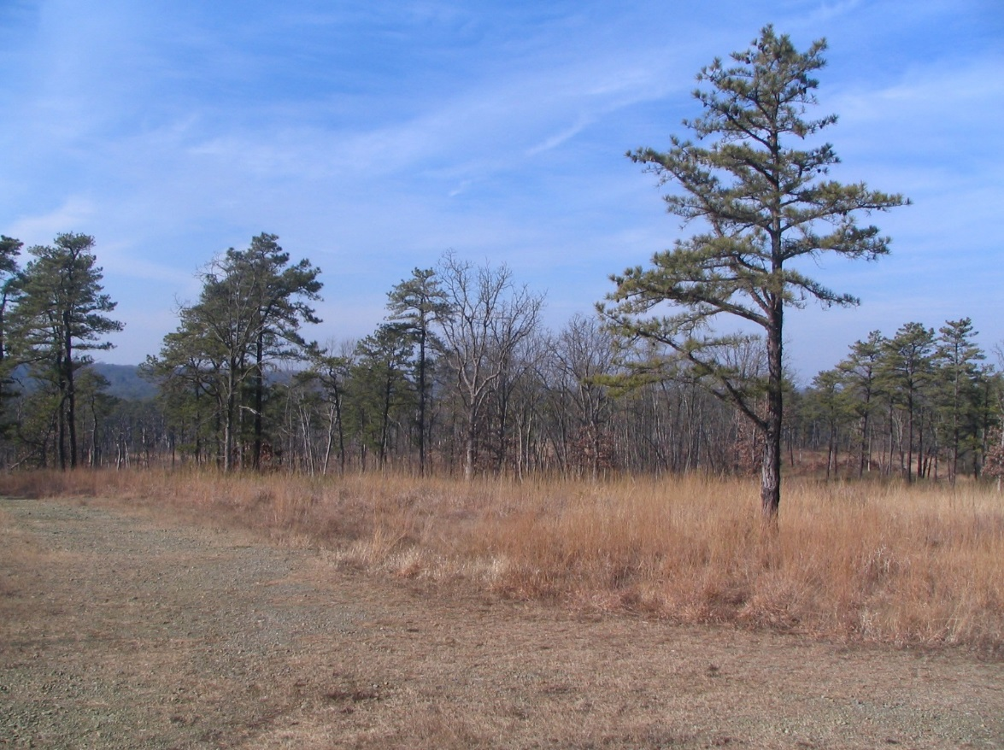
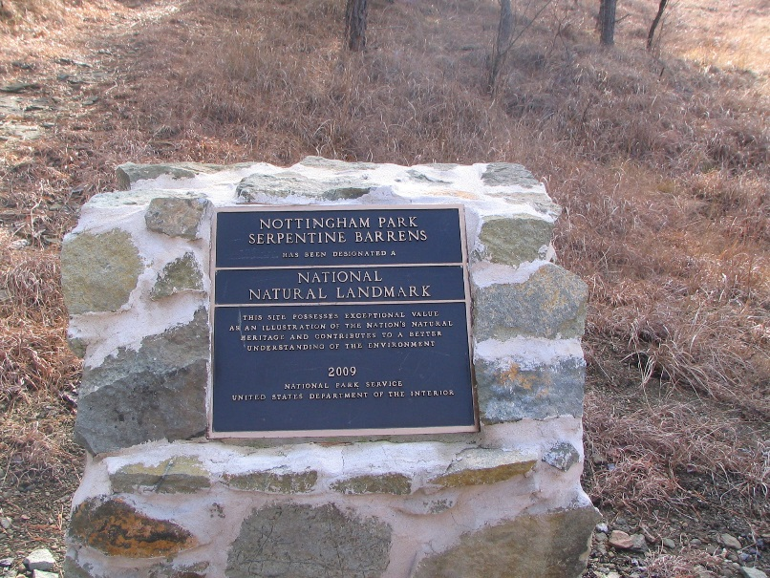
The Pitch Pine is also well-adapted to the naturally metalliferous Serpentine Pine Barrens in southeast PA
Notes:
High levels of nickel, chromium, and magnesium

Slide 7
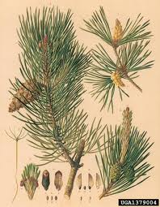
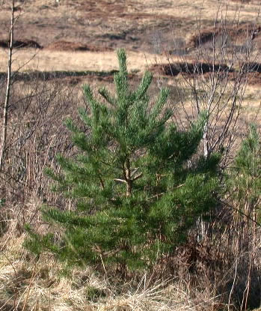
Studies on a related species (P. sylvestris or Scots pine) native to northern Europe, have shown that ectomycorrhizal fungi can ameliorate the toxic effects of heavy metals on this species
e.g., Adriaensen, K. et al., (2006) Mycorrhiza 16:553-558

Slide 8
The heavy metals examined in the European studies (Zn, Cd, & Cu) are the same as those present at the Palmerton site

Slide 9
Studies have shown that the soil concentrations of these metals decrease with distance from Palmerton

Slide 10
Relating Injury to the Forest Ecosystem Near Palmerton, PA
to Zinc Contamination From Smelting
W. N. Beyer et al., Arch Environ Contam Toxicol (2011) 61:376–388

Slide 11
2008
←No seeding; no mycorr- inoculation / Seeded; yes mycorr- inoculation →

Slide 12
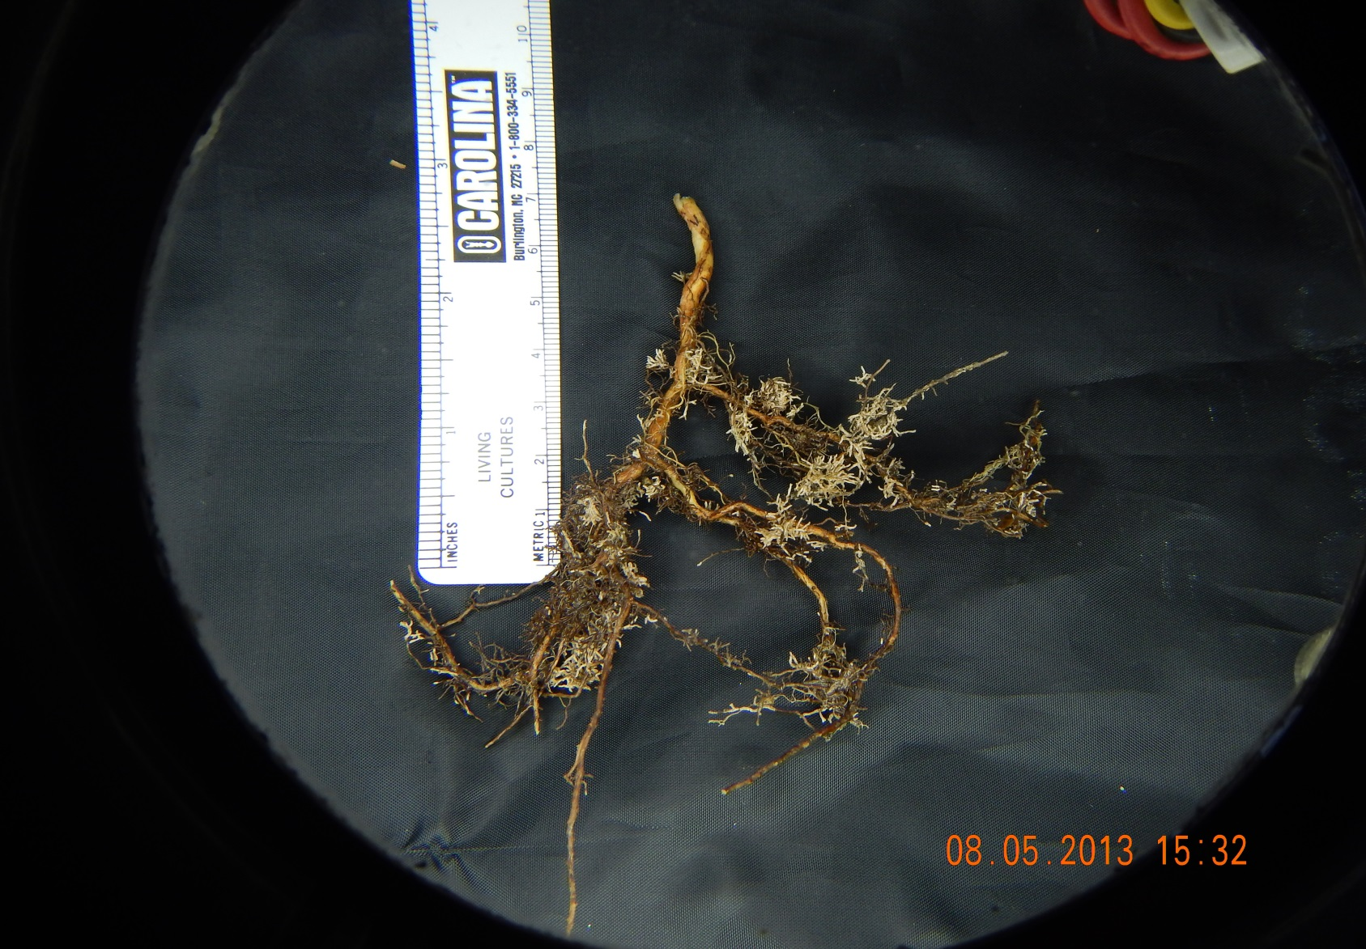
Five years later, I collected root tips from Pitch pine seedlings at 10 sites along above Palmerton, and 25 Km to the west

Slide 13
2008
←No seeding; no mycorr- inoculation / Seeded; yes mycorr- inoculation →

Slide 14
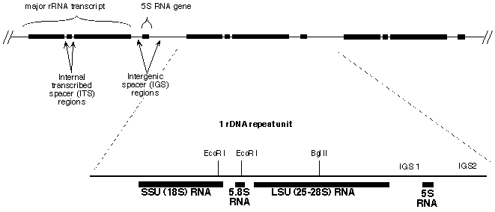
We are using a metagenomic approach to examine fungal genetic diversity in those roots
http://biology.duke.ehttp://biology.duke.edu/fungi/mycolab/primers.htmdu/fungi/mycolab/primers.htm

